Slide 1
Chemical identification with time series feature extraction
Chemical->Trufflebot->pattern->multivariable time series-> features -> classification

Slide 2
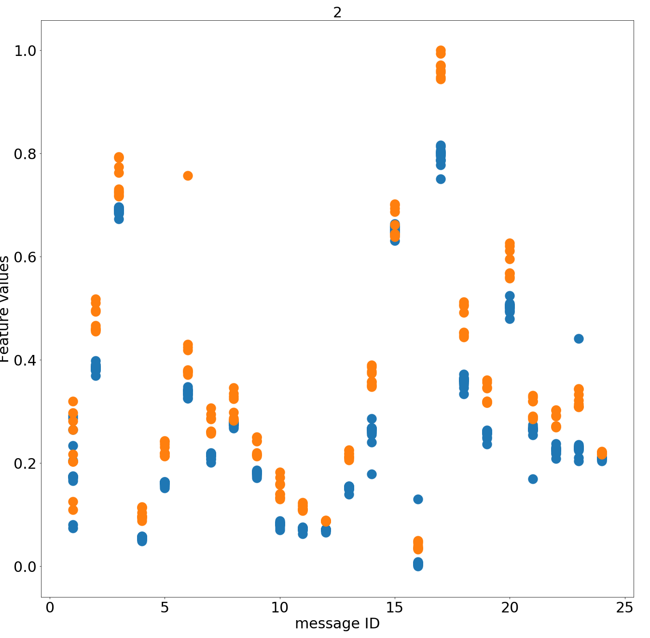
The data so far:
EtOH and Acetone.
Both analyzed with ≈8-16 repetitions of 24 different patterns.
We look at 219 features for each variable, and its derivative
Therefore, we have 6x219x8 features per observation
Here, we limit ourselves to just sensor 1 of 8
Feature 2, chemicals are different colors
good
bad
Executive summary:
No pattern does better or worse than others on average, but classification accuracy for a given feature varies with pattern sent.
‘best’ chemical identification will take into account both pattern and feature information
24 patterns

Slide 3
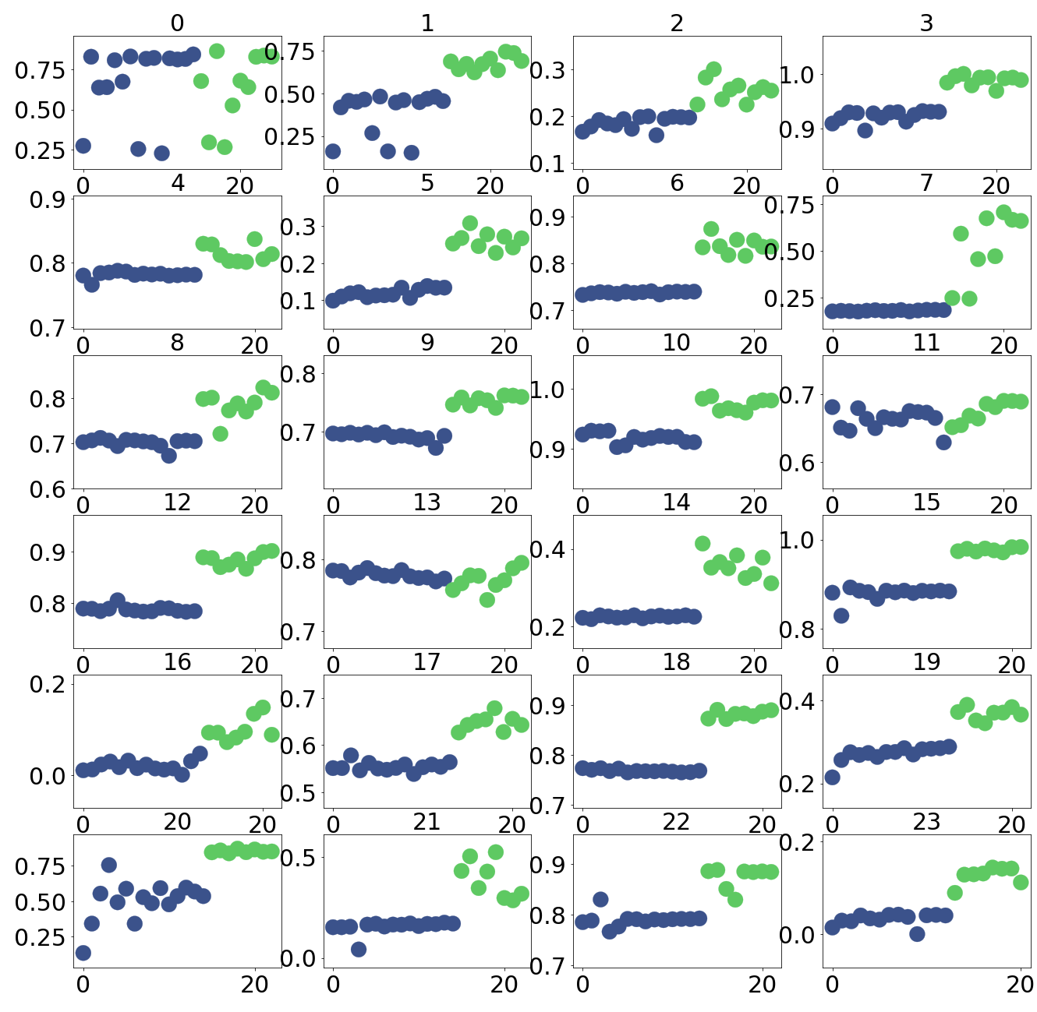
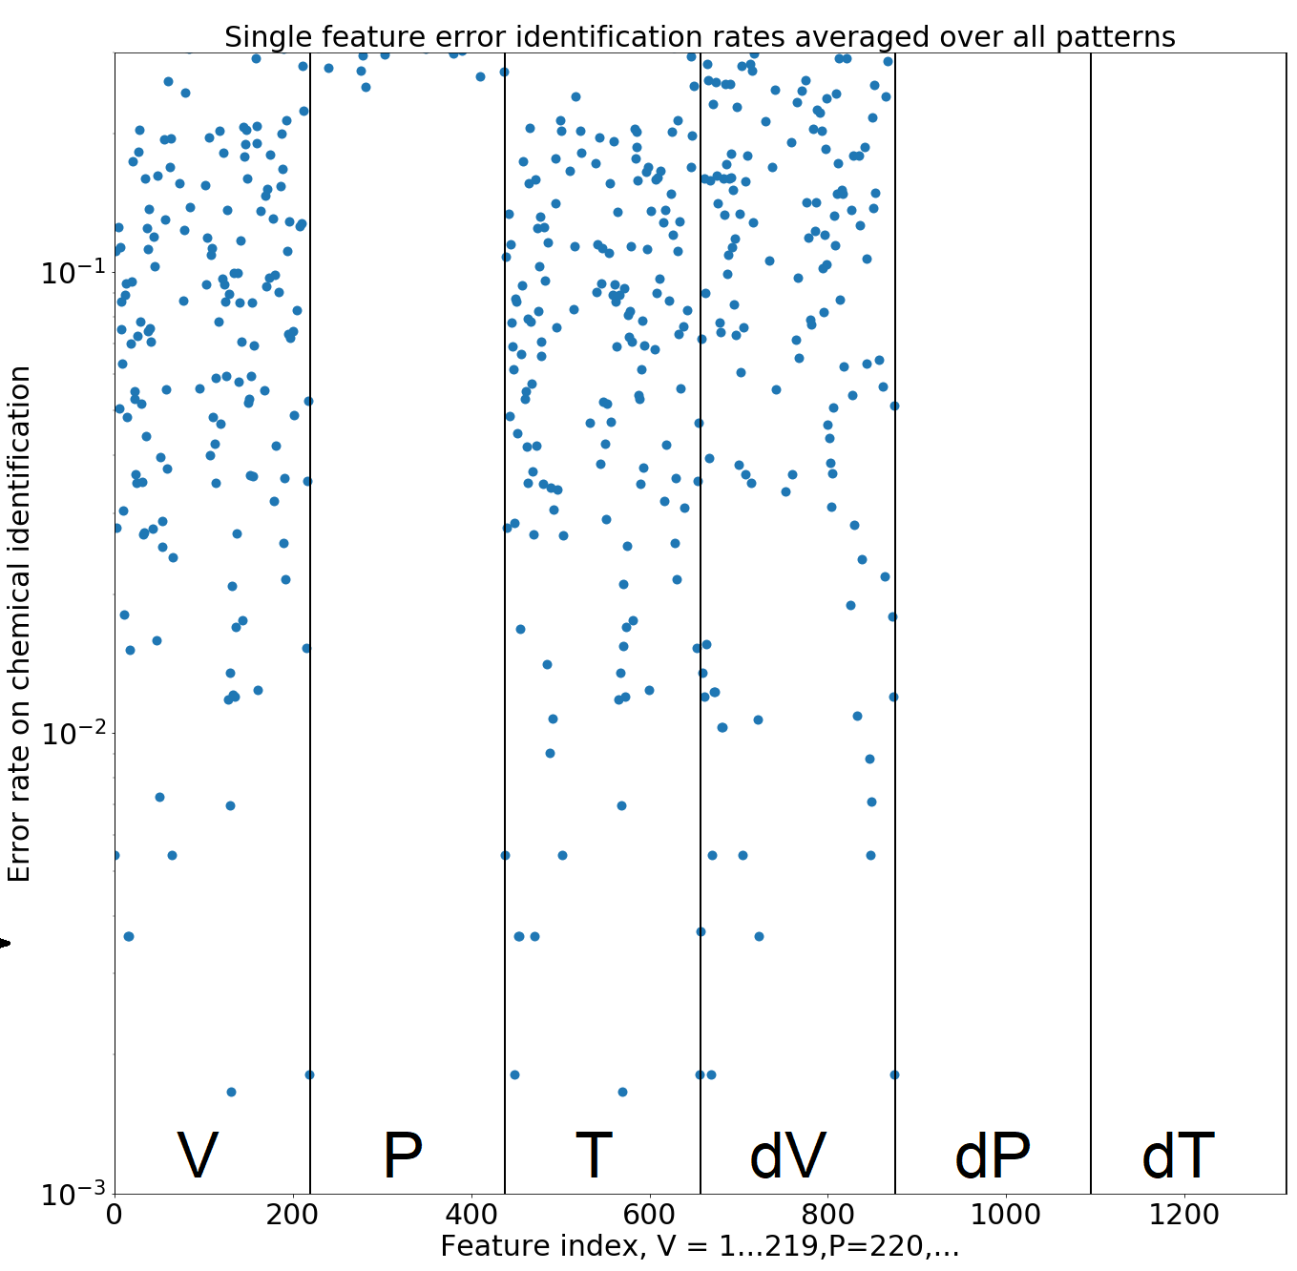
1 feature, all patterns, 2 chemicals
All single features, fraction chemical correct
≈1/500
Creates a single average chemical identification error rate
over all patterns

Slide 4
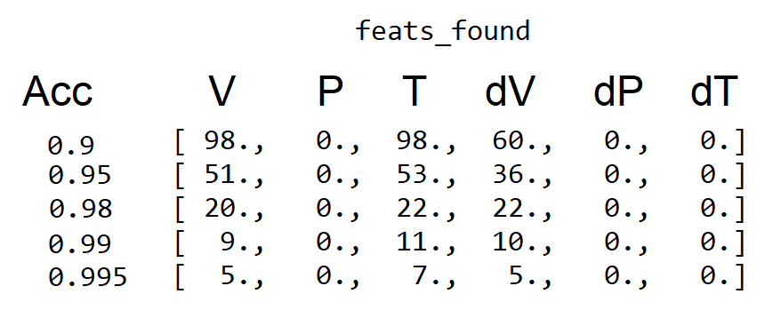
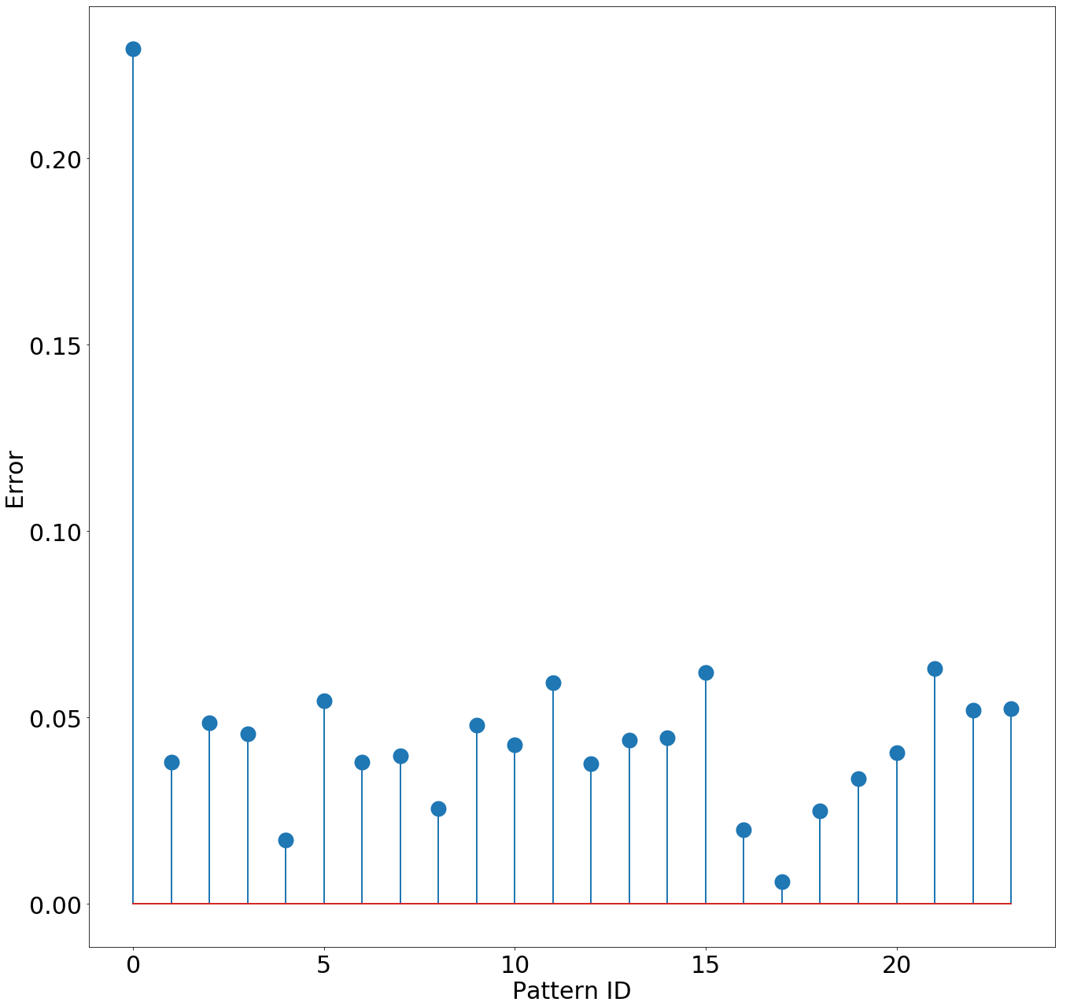
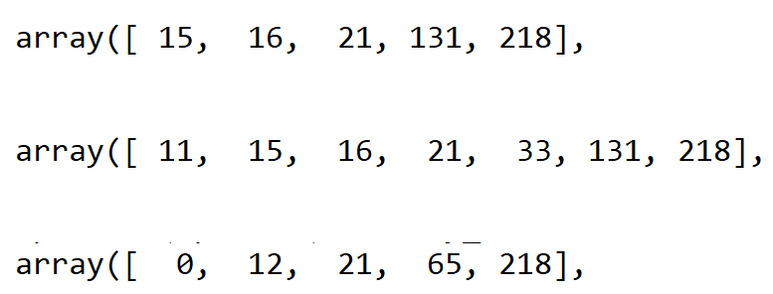
Results broken out by pattern, and by # good features:
Number of single features classifying at >95% is 140:
About 10 single features each correctly identify virtually all 339 EtOH and 211 Acetone traces
A logistic classifier will get 100% here
Next steps: Add more chemicals
17 is best, 1 is outlier/worst
Patterns behave similarly
Feature indices achieving >0.995:
V
T
dV
Some similarity but dV is quite different

